Slide 1

If301 database system
Dennis Gunawan
09 transaction processing, concurrency, and recovery techniques

Slide 2
Review: select statement 3
JOIN
Set Operator

Slide 3
outline
Transactions
Concurrency
Recovery Techniques
Transaction Processing in MySQL

Slide 4
Single-user vs multiuser systems
A DBMS is single-user if at most one user at a time can use the system
It is multiuser if many users can use the system and hence access the database concurrently
For example, an airline reservations system is used by hundreds of travel agents and reservation clerks concurrently

Slide 5
transactions
An executing program that forms
a logical unit of database processing
A transaction includes one or more database access operations (insertion, deletion, modification, or retrieval operations)
If the database operations in a transaction do not update the database but only retrieve data, the transaction is called a read-only transaction
Otherwise it is known as a read-write transaction

Slide 6
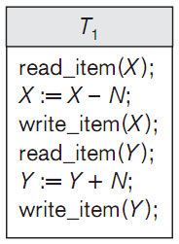
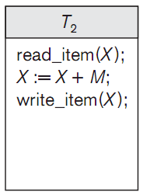
transactions
The basic database access operations that a transaction can include
read_item(X) reads a database item named X into a program variable
write_item(X) writes the value of program variable X into the database item named X

Slide 7
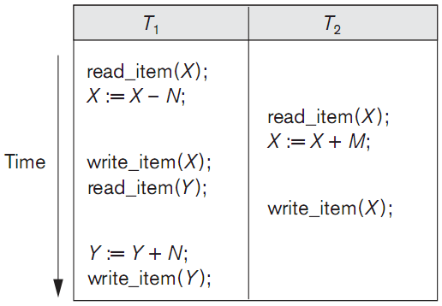
Why concurrency control is needed: the lost update problem
This problem occurs when two transactions that access the same database items have their operations interleaved in a way that makes the value of some database items incorrect
Item X has an incorrect value because its update by T₁ is lost (overwritten)

Slide 8
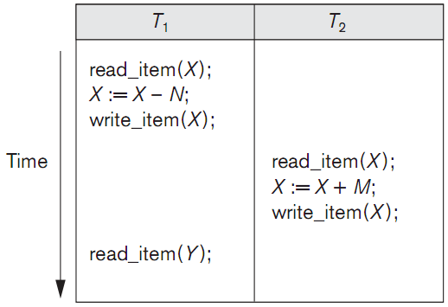
Why concurrency control is needed: the temporary update (or dirty read) problem
This problem occurs when one transaction updates a database item and then the transaction fails for some reason
Meanwhile, the updated item is accessed (read) by another transaction before it is changed back to its original value
Transaction T₁ fails and must change the value of X back to its old value; meanwhile T₂ has read the temporary incorrect value of X

Slide 9
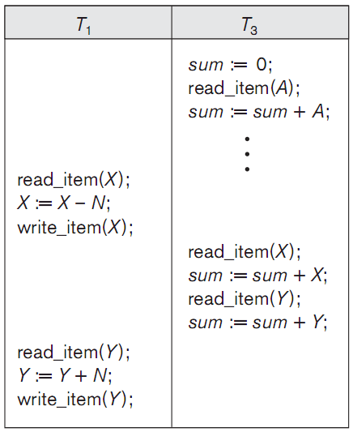
Why concurrency control is needed: the incorrect summary problem
If one transaction is calculating an aggregate summary function on a number of database items while other transactions are updating some of these items, the aggregate function may calculate some values before they are updated and others after they are updated
T₃ reads X after N is subtracted and reads Y before N is added; a wrong summary is the result (off by N)

Slide 10
Why recovery is needed
A computer failure (system crash)
Hardware, software, or network error occurs in the computer system during transaction execution
Hardware crashes are usually media failures, for example main memory failure
A transaction or system error
Some operation in the transaction may cause it to fail
Integer overflow
Division by zero
Erroneous parameter values
Logical programming error

Slide 11
Why recovery is needed
Local errors or exception conditions detected by the transaction
During transaction execution, certain conditions may occur that necessitate cancellation of the transaction
Data for the transaction may not be found
Insufficient account balance in a banking database
Concurrency control enforcement
The concurrency control method may decide to abort a transaction because it violates serializability, or it may abort one or more transactions to resolve a state of deadlock among several transactions

Slide 12
Why recovery is needed
Disk failure
Some disk blocks may lose their data because of a read / write malfunction or because of a disk read / write head crash
Physical problems and catastrophes
Power or air-conditioning failure
Fire
Theft
Sabotage
Overwriting disks or tapes by mistake
Mounting of a wrong tape by the operator

Slide 13
Transaction states & operations
A transaction is an atomic unit of work
that is either completed in its entirety
or not done at all
Recovery manager keeps track of the following operations
BEGIN_TRANSACTION
READ OR WRITE
END_TRANSACTION
COMMIT_TRANSACTION
ROLLBACK (or ABORT)

Slide 14
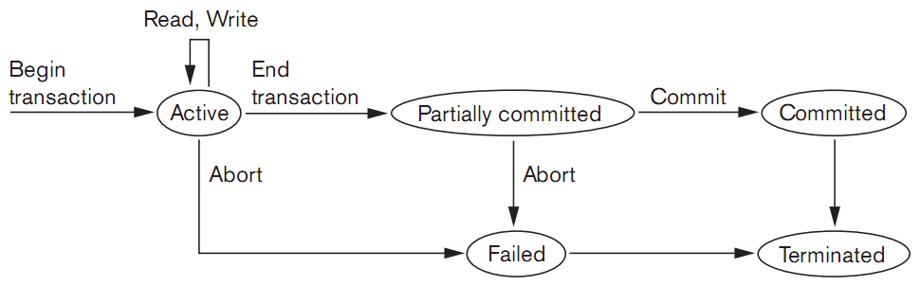
Transaction states & operations
State transition diagram illustrating the states for transaction execution

Slide 15
Commit point of a transaction
A transaction T reaches its commit point when all its operations that access the database have been executed successfully and the effect of all the transaction operations on the database have been recorded in the log
Beyond the commit point, the transaction is said to be committed, and its effect is assumed to be permanently recorded in the database
The transaction then writes a commit record into the log

Slide 16
Commit point of a transaction
If a system failure occurs, we search back in the log for all transactions T that have written a start_transaction record into the log but have not written their commit record yet
These transactions may have to be rolled back to undo their effect on the database during the recovery process
Transactions that have written their commit record in the log must also have recorded all their WRITE operations in the log, so their effect on the database can be redone from the log records

Slide 17
Properties of transactions: acid
Atomicity
A transaction is an atomic unit of processing
It is either performed in its entirety or not performed at all
Consistency preservation
A transaction is consistency preserving if its complete execution takes the database from one consistent state to another

Slide 18
Properties of transactions: acid
Isolation
A transaction should appear as though it is being executed in isolation from other transactions
The execution of a transaction should not be interfered with by any other transactions executing concurrently
Durability or permanency
The changes applied to the database by a committed transaction must persist in the database
These changes must not be lost because of any failure

Slide 19
Transaction rollback
If a transaction fails for whatever reason after updating the database, it may be necessary to roll back the transaction
If any data item values have been changed by the transaction and written to the database, they must be restored to their previous values
The undo-type log entries are used to restore the old values of data items that must be rolled back

Slide 20
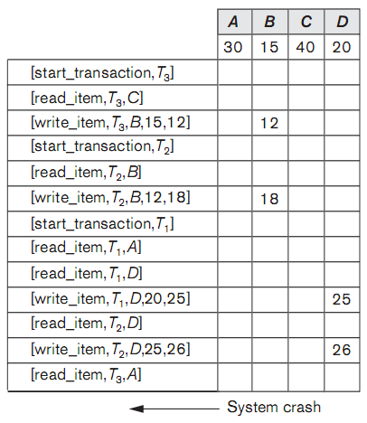
Transaction rollback
Cascading rollback
If a transaction T is rolled back, any transaction S that has read the value of some data item X written by T must also be rolled back
Once S is rolled back, any transaction R that has read the value of some data item Y written by S must also be rolled back
And so on…
T₃ is rolled back because it did not reach its commit point
T₂ is rolled back because it reads the value of item B written by T₃

Slide 21
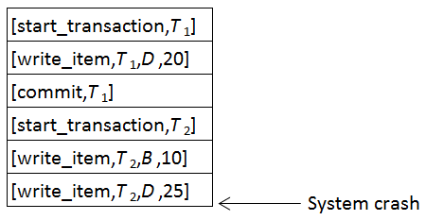
Recovery techniques
The [write_item,…] operations of T₁ are redone
T₂ log entries are ignored by the recovery process

Slide 22
Checkpoints in the system log
A [checkpoint] record is written into the log periodically at that point when the system writes out to the database on disk all DBMS buffers that have been modified
As a consequence of this, all transactions that have their [commit, T] entries in the log before a [checkpoint] entry do not need to have their WRITE operations redone in case of a system crash, since all their updates will be recorded in the database on disk during checkpointing

Slide 23
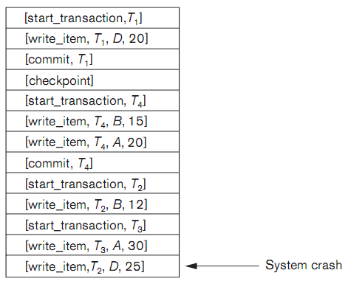
Recovery techniques
T₂ and T₃ are ignored because they did not reach their commit points
T₄ is redone because its commit point is after the last system checkpoint

Slide 24
Transaction processing in mysql
When a session is started in MySQL, the AUTOCOMMIT system variable is normally turned on
The following statement turns off autocommit
When autocommit must be turned on again, issue this statement
SET @@AUTOCOMMIT = 0;
SET @@AUTOCOMMIT = 1;

Slide 25
Transaction processing in mysql
The change can be undone with the SQL statement ROLLBACK or made permanent with the COMMIT statement
COMMIT statements make the changes permanent
ROLLBACK statements undo the changes
COMMIT;
ROLLBACK;

Slide 26
Transaction processing in mysql
It is also possible to undo only a part of a current transaction by using savepoints
To use savepoints, we must extend the ROLLBACK statement
SAVEPOINT savepoint_name;
ROLLBACK TO SAVEPOINT savepoint_name;

Slide 27
references
Elmasri, Ramez and Shamkant B. Navathe (2011), Fundamentals of Database Systems, 6th edition, Addison Wesley.
Rick F. van der Lans (2007), SQL for MySQL Developers, Addison Wesley.
Connolly, Thomas and Carolyn Begg (2015), Database Systems A Practical Approach to Design, Implementation, and Management, 6th edition, Pearson Education, ISBN 13: 978-1-292-06118-4, Essex, England.

Slide 28
Next week: database security
Discretionary Security Mechanisms
Mandatory Security Mechanisms
VIEW
Adding & Removing Users
Granting, Passing On, & Revoking Privileges
Creating, Updating, & Deleting Views

Slide 29
Select * from world where someone like ‘%you%’; empty set (0.00 sec)

Slide 30
Vision
To become an outstanding undergraduate Computer Science program that produces international-minded graduates who are competent in software engineering and have entrepreneurial spirit and noble character.
INFORMATIKA
Mission
To conduct studies with the best technology and curriculum, supported by professional lecturer
To conduct research in Informatics to promote science and technology
To deliver science-and-technology-based society services to implement science and technology

